Slide 1
MERCURIUS SOLUBILIS
Dr Gokul Krishna K

Slide 2
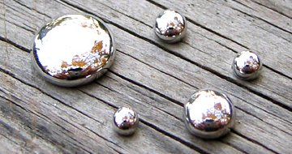
Mercury is a dense silvery white poisonous metal with a mirror like appearance.
It’s the only common metal that is liquid at room temperature.
Colour- silvery white colour

Slide 3
Uses of Mercury
Mercury is used in barometers and manometers (instruments for measuring the pressure of gases and liquids), because of its high density.
Various compounds of mercury are used in medicine, dentistry, cosmetics (mascara) and also in agriculture to make fungicides.

Slide 4
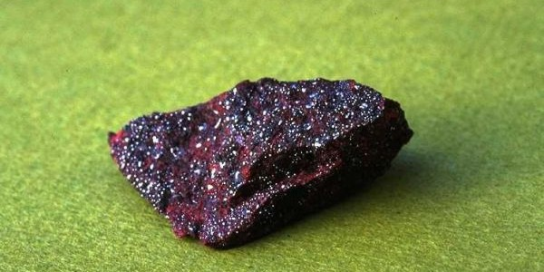
Synonym :
Quicksilver, Mercury, Black Oxide of Mercury, Nitrate of Mercury

Slide 5
SPHERE OF ACTION
Bones, glands, lymphatic, mucous membrane, intestine, blood
CONSTITUTION
Light hair, lax muscle and skin, youthful, over weight, small weak chin
TEMPERAMENT
Easily frightened with hurried and rapid speech

Slide 6
RELATION WITH HEAT AND COLD
Mercurius is said to be the human barometer, easily affected by both extremes of heat and cold
MIASM
King of Anti- syphilitic (traces of psora and sycosis also seen)
PROVER
DR. HAHNEMANN

Slide 8
PHYSICAL GENERALS
All complaints aggravation from sunset to sunrise (esp. bone pains)
Profuse offensive perspiration with every complaints which gives no relief; may even increases the suffering (Perspiration amel - ????)
Discharges from mucous membrane are slimy(greasy)

Slide 9
Every little injury suppurates
Breath and body smell foul (psorn)
Great weakness and trembling from least exertion
Mostly right sided affection seen

Slide 10
MIND
Destructiveness
Elusiveness (difficult to describe)
Restlessness
Sluggishness
Fear of falling, murder, death, suicide

Slide 11
HEAD
Vertigo, when lying on back
Band like feeling
One sided headache
Oily sweat on head
Loss of hair

Slide 12
EYES
Lids red, thick swollen, profuse, burning, acrid discharge; after exposure to glare of fire
Parenchymatous keratitis
Floating black spots
Iritis

Slide 13
NOSE
Nasal catarrh, sneezing of fluent acrid corrosive discharge
Raw and ulcerated nostrils
Yellow green, foetid pus like, and bloody discharge
Modality - < night, damp weather

Slide 14
MOUTH AND THROAT
Tonsillitis, diphtheria, laryngitis, pharyngitis, mumps
Constant desire to swallow
Putrid discharge with profuse, offensive saliva
Metallic taste

Slide 15
Tongue large, flabby with imprint of teeth( ???)
Mapped tongue ( ????)
Crowns of teeth decay, roots remain (crowns intact, root decay – mez)

Slide 16
TOOTH
Pulsating, tearing, shooting into face or ears
<evening air, cold or warm things
> from rubbing the cheek
Ptyalism- Soapy, stringy, profuse, foetid, coppery, metallic tasting saliva

Slide 17
GIT
Dysentery
Causation- Fright and suppressed sweat
Character of stool
- Slimy, bloody, very offensive stool
- Cannot finish sensation; tenesmus not relived after stool

Slide 18
Modality - night
Concomitant – colic and fainting with creeping chillness and thirst

Slide 19
URINARY
Quantity of urine voided is larger than the amount of fluid drunk
Frequent urging to urinate every ten minutes esp night but only a little quantity passes out at a time
Burning urethra- during and after micturation

Slide 20
MALE
Nocturnal emissions stained with blood ( led, sars)
Vesicles and ulcers
Soft chancre, cold genitals
Itching

Slide 21
FEMALE
Leucorrhea – Greenish, biting, acrid, fetid leucorrhea with much scratching, esp. night, and also rawness in the area
Breast – Mammae are painful as if they would ulcerate at every menstrual period ( lac.can, conium)
Milk in breast instead of menses
Modalities- < contact of urine, and > washing with cold water

Slide 22
RESPIRATORY SYSTEM
Cough- Dry, fatigue
Cough in 2 paroxysm (3 paroxysm- ??????)
worse at night, warmth of bed
Inability to lie on right side(inability to lie on left side - ???)

Slide 23
Affects lower lobe of right lung( ?????)
Stitches from lower lobe of right lung to back
Suppuration of lungs, after hemorrhages of pneumonia
Cough worse by tobacco smoking

Slide 24
SKIN
Every little injury suppurates (?????)
Profuse, offensive, not relieved by sweat, skin moist
Abscesses when suppuration has set in with intense pain at night

Slide 25
Vesicular or pustular eruptions, with yellowish brownish crust and offensive discharge
< warmth of bed

Slide 26
ULCERS
Irregular in shape with undefined edges
Margins are everted like raw meat, and base is covered with caseous coat, having a dirty unhealthy look
Large ulcers bleed easily when touched and there is pain affected whole body
Rapidly decomposing ulcers on legs, < night

Slide 27
MODALITIES
Aggravation :
Night, damp wet weather, lying on right side, perspiration ; warm room and warm bed
Amelioration :
Rest, weeping

Slide 28
RELATIONS
Antidoted bad effects of sugar, stings of insects
Antidoted by aurum, hepar, nit.acid
Incompatible –silicea
Follows well – Bell, in inflammatory condition

Slide 29
?????????

Slide 30
???????

Slide 31
??????

Slide 32
??????

Slide 33
????????

Slide 34
??????

Slide 35
??????

Slide 36
????

Slide 37
Chancre

Slide 38
THANK YOU…………….

